Slide 1
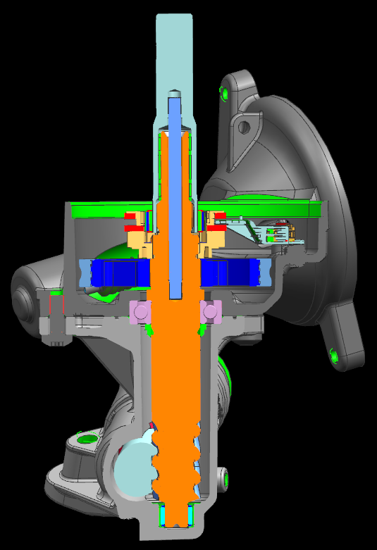
RCM-109: Non-Delashed Pinion
Last updated: 02SE15
Description
Describe the issue
Motivation : 4
Deliverables
Concept and prove a non-delash gear axis.
Support implementation.
Timing
Provide design in time for 1v5 and Next Gen UKL
Samples ordered on time
Team Members/Customers
Team Members: Jason Kandal
Customers: Johan Pieters, Don Smith

Slide 2
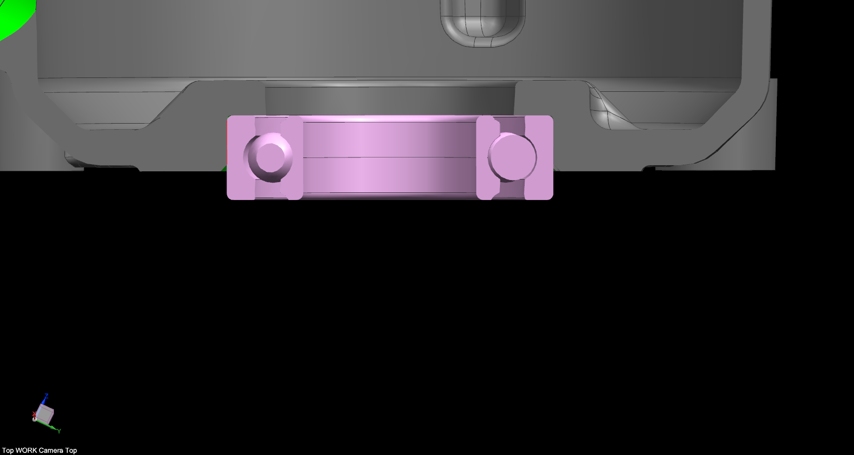
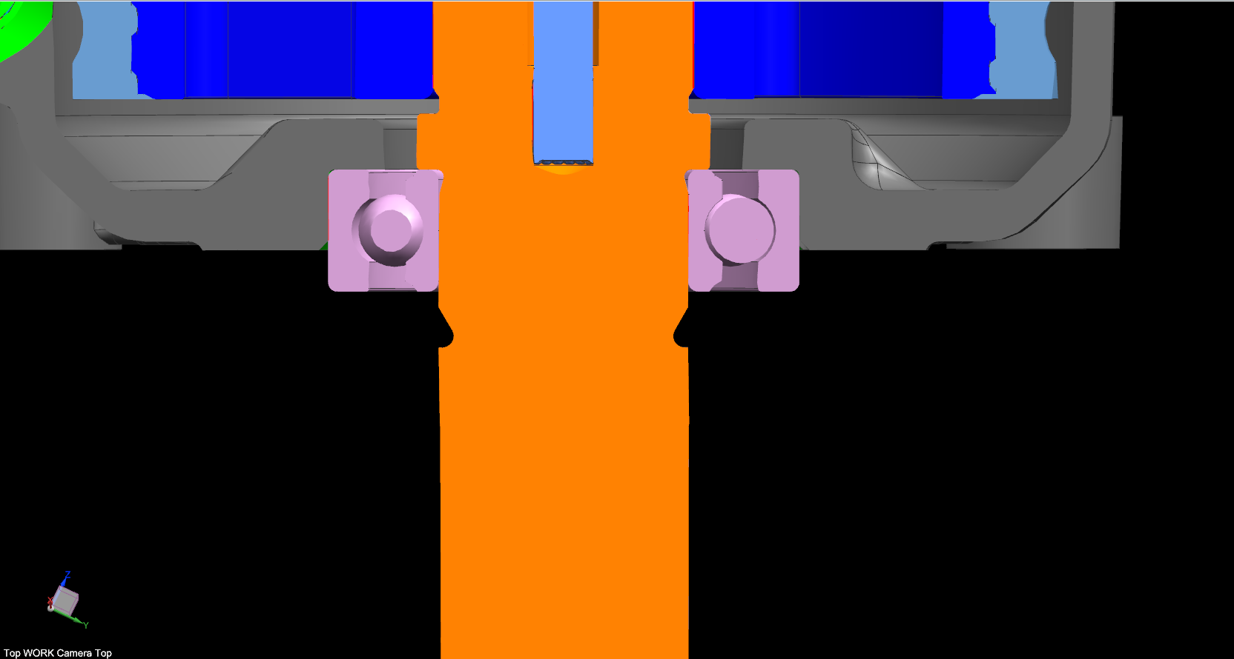
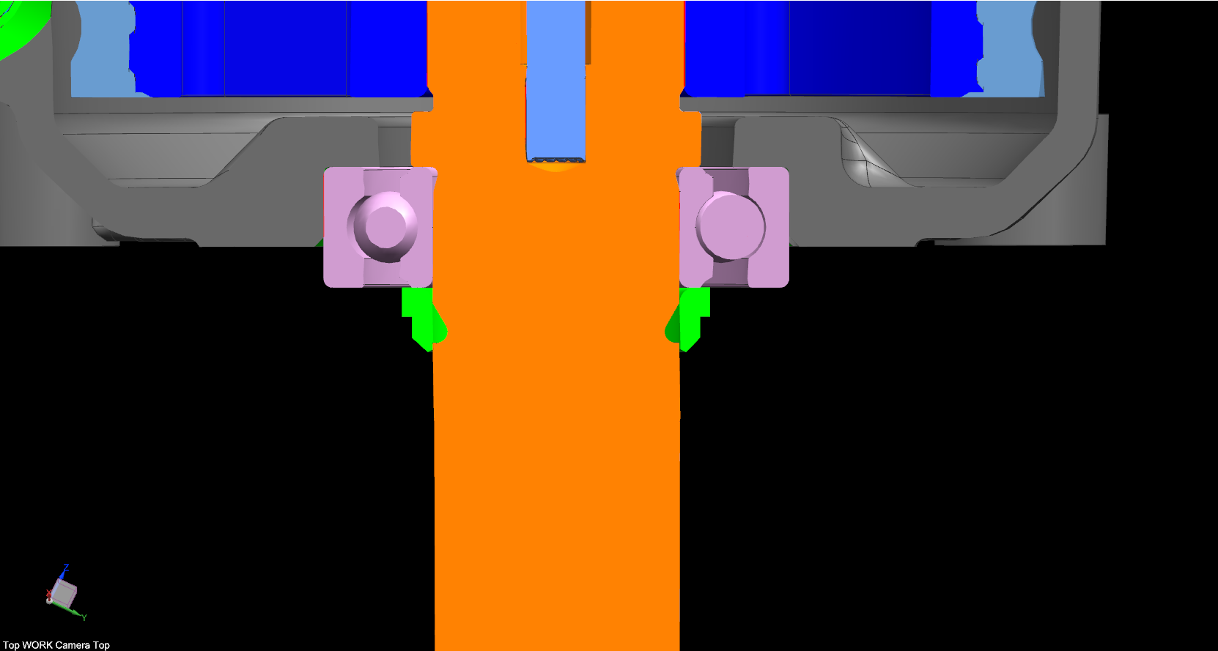
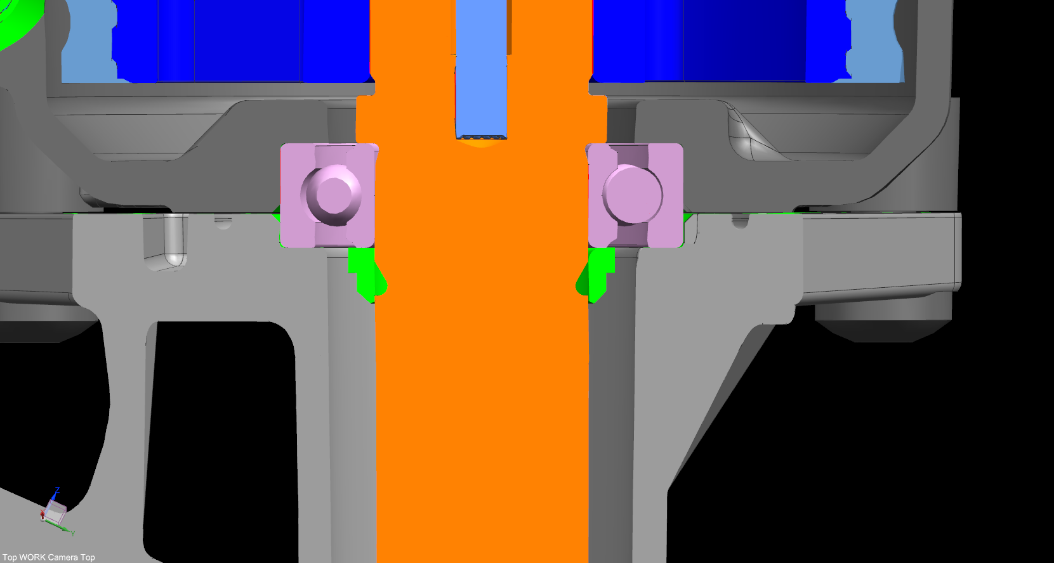
RCM-109: Non-Delashed Pinion
Last updated: 02SE15
Status Update:
Design complete
FEA complete
Review w/ plant and 1v5 team complete
Challenges:
Production intent NVH
Next Actions:
Receive samples
Test on durability and in vehicle
Gap remains
Gap closed

